Slide 1



CHALLENGE-HEALTH CARE ANALYSIS
By Nivin K P

Slide 2


WHAT’S THE CHALLENGE .?
You have been asked to analyse the hospital records to track the progress of some common illnesses so you can help inform a public health programme.

Slide 3
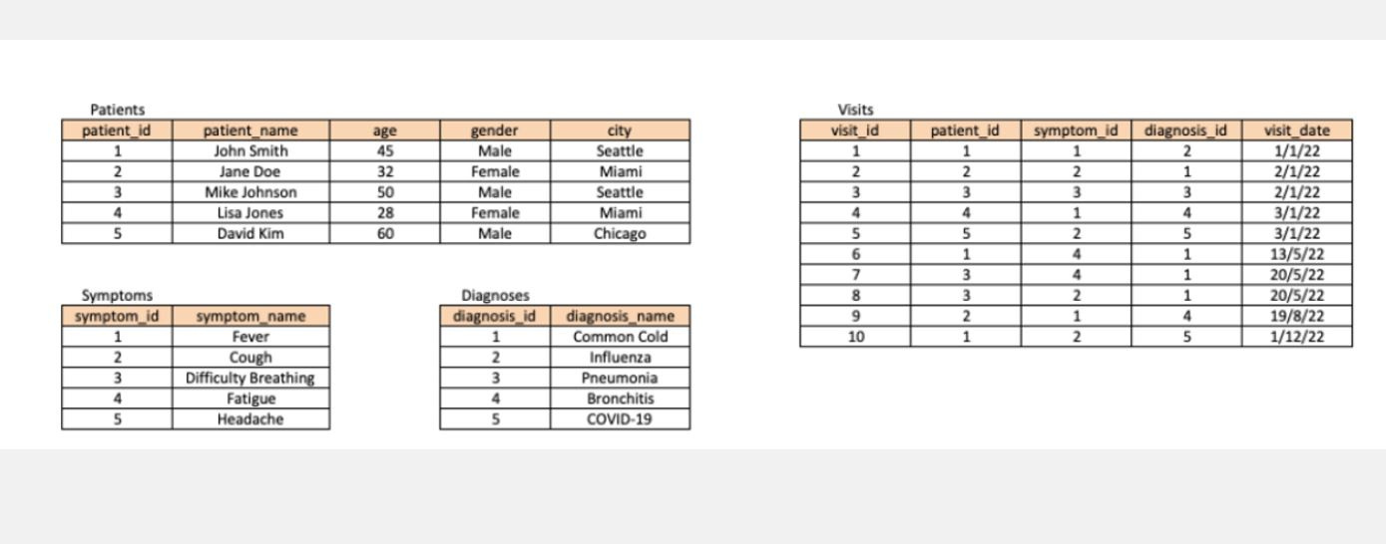
TABLES

Slide 4
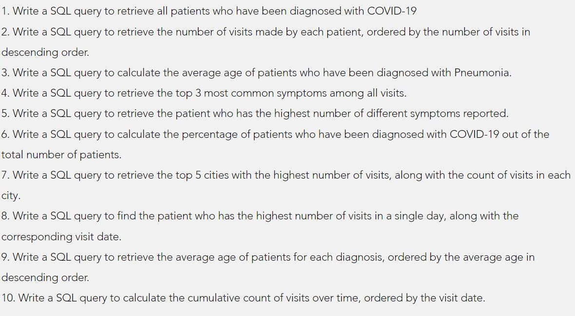

Questions

Slide 5
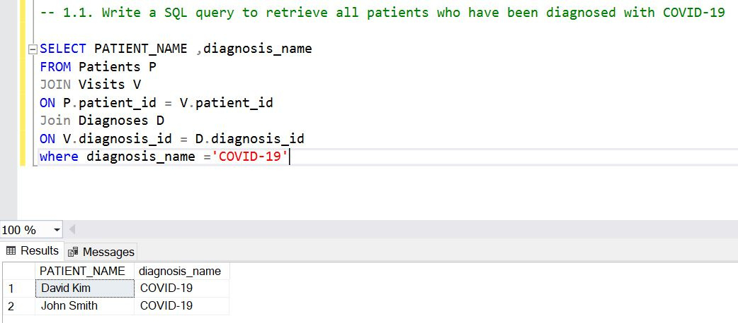

Slide 6
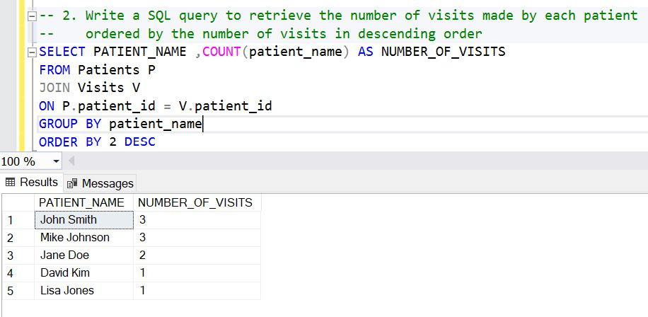

Slide 7
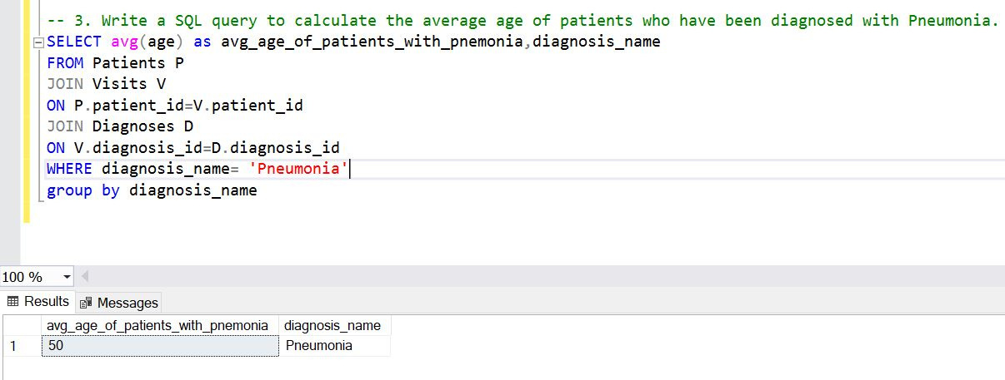

Slide 8
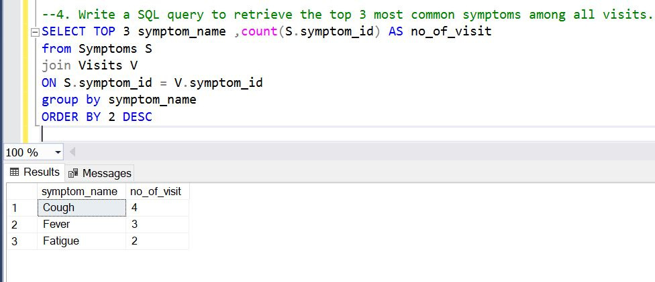

Slide 9
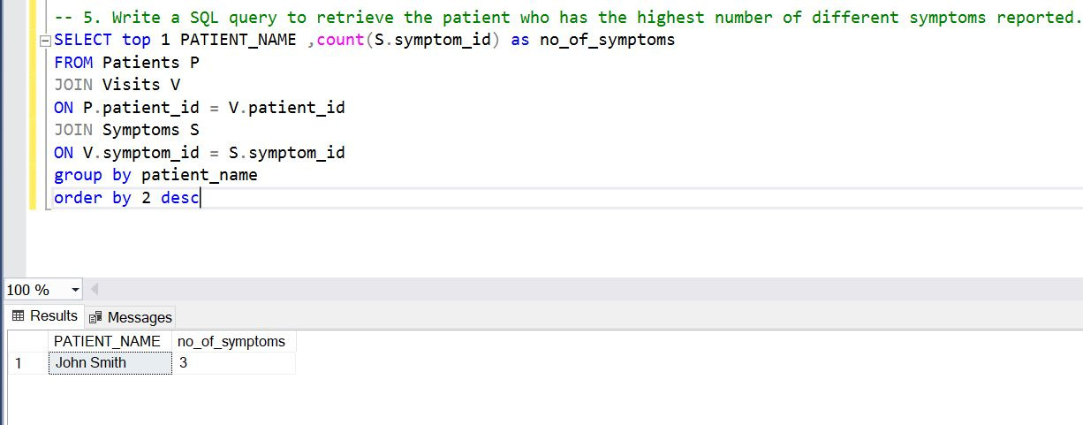

Slide 10
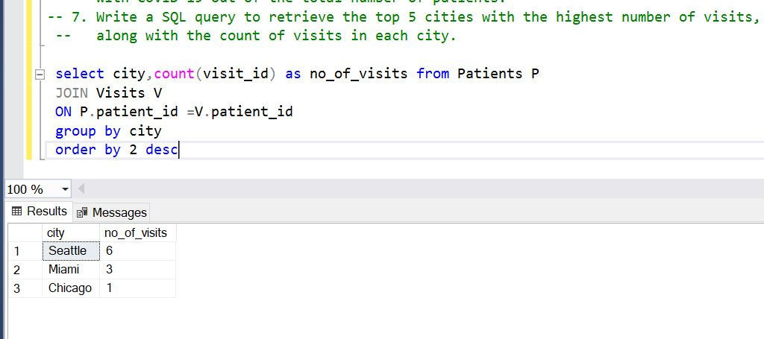

Slide 11
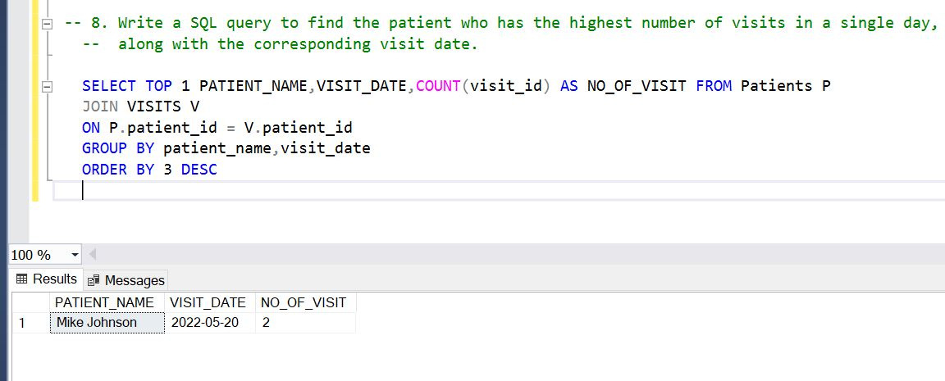

Slide 12
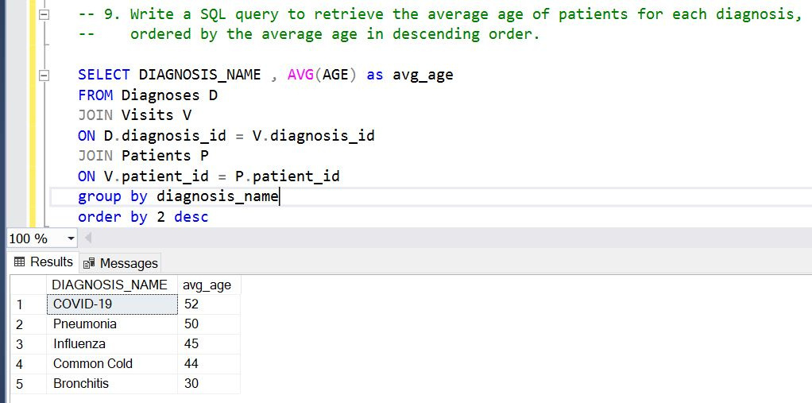

Slide 13
